Slide 1
SPIKING NEURAL NETWORKS FOR FAST-MOVING OBJECT DETECTION
Mario Real Enrique

Slide 2
New problem
In previous presentations: (x, y)
From now on: (x, y, R)
This is necessary for 3D localization
R values obtained from real-world data were not good
Ground truth for positions was not good either
Also, the data was scarce (17 throws)
Thus, a new dataset was needed

Slide 3
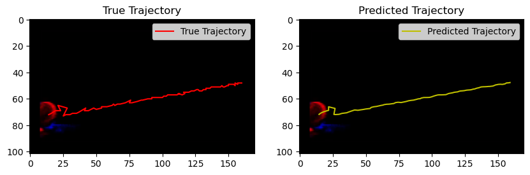
Proof that the ground truth wasn’t good

Slide 4
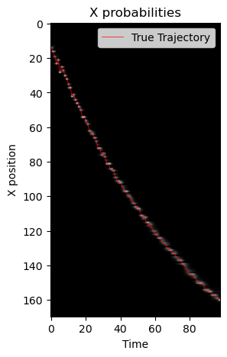
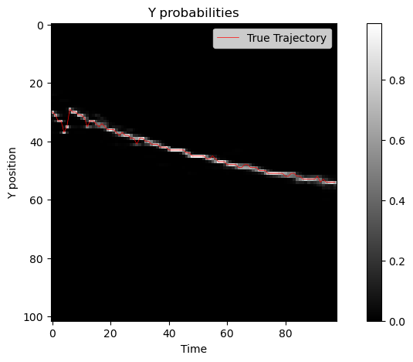
Proof that the ground truth wasn’t good

Slide 5
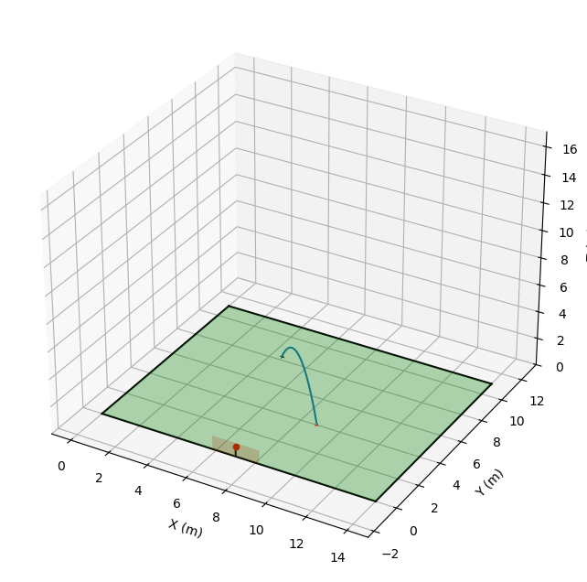


New Dataset
Synthetic dataset
Trajectories
Videos
Events
Composition of the data:
Half rolls, half throws
70 % go in
15% almost go in
15% go out

Slide 6
Architecture
X SFCL
X prediction
EVENT DATA
2 channels
(+, -)
3 Layer SCNN
Y SFCL
Y prediction
R SFCL
R prediction

Slide 7
Big Problem
The loss is not getting low enough
Why?
In rolls the ball moves slowly, so the ball is barely visible
Throws often go out of the FOV
Solutions
Enhance contrast
PISNN

Slide 8
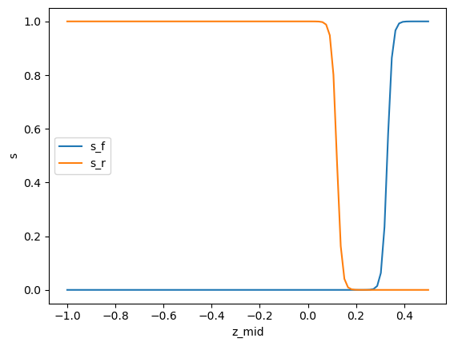
PISNN
The idea is to include physics in the loss function
L = L_data + L_phys
L phys would have two regimes for rolls and throws
L_roll = z^2 + a_z^2
L_throw = a_x^2 + a_y^2 + (a_z + g)^2
Integration between these losses would be done through two sigmoids on the predicted height z

Slide 9
Next Steps
Implement recurrency in the network
Stick to just throws
Stick to just rolls (ball stays in the FOV)

Slide 10
Alternative approach
KF when the ball is not in view

